Slide 1

Team Name : Stumble Guys
Team Leader Name : Fahad Nawaz
Problem Statement: The "Missing Indian" in Global Medicine
Indians constitute 18% of the global population, yet they account for less than 2% of participants in worldwide clinical trials. This significant under representation means that most medications are never tested on Indian genetic profiles. The consequence is often unknown side effects and reduced treatment efficacy for our population.

Slide 2
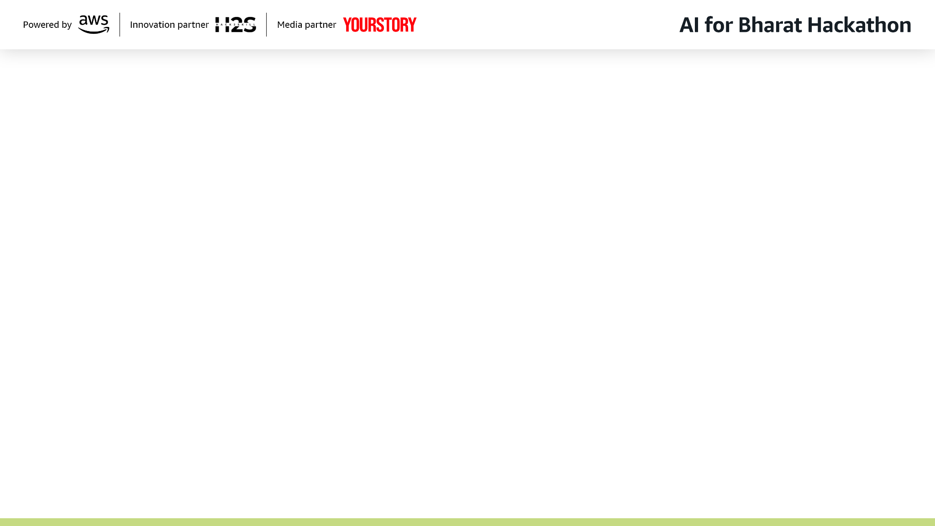

Brief Summary:-
Trial-Scout: Bridging the Gap for Indian Healthcare
Trial-Scout is an Agentic AI System designed to democratize access to clinical trials for the Indian population. Using a Hybrid Multi-Agent Architecture, it matches Indian patients who often have complex and undocumented medical histories to relevant global and local trials.
Core Value:
Trial-Scout ensures that "Bharat" is no longer invisible in medical research. It helps Indians access cutting-edge treatments while generating crucial data on how drugs affect South Asian ethnicities.

Slide 3
Solution:-
How different is it from any of the other existing ideas? | How will it be able to solve the problem? | USP of the proposed solution
Agentic vs. Static: Unlike rigid sites (e.g., clinicaltrials.gov) requiring manual filtering, Trial-Scout uses a Multi-Agent Architecture to proactively extract complex eligibility factors like dialysis status or age range. | Streamlined Automation: It uses AI agents to automate complex matching (age, genotype, disease stage), completely removing the technical burden from the patient. | Vernacular Bridge: Removes the English-only barrier through Hinglish/Indian Native Language Chat Agents, allowing non-technical users to provide context through natural dialogue.
Parsing Indian Chaos: Specifically built to handle unstructured data (handwritten notes/PDFs) using Amazon Textract, solving for the lack of digital records in India—something Western apps cannot do. | Meaningful Contribution & Hope: For patients with incurable diseases, it provides a direct path to cutting-edge trials, giving them a fighting chance against their condition while advancing research for future generations. | Interactive "Scribe": A unique engine that converts fragmented, chaotic medical history into a Standardized JSON Profile automatically, making the patient "trial-ready" in minutes.

Slide 4
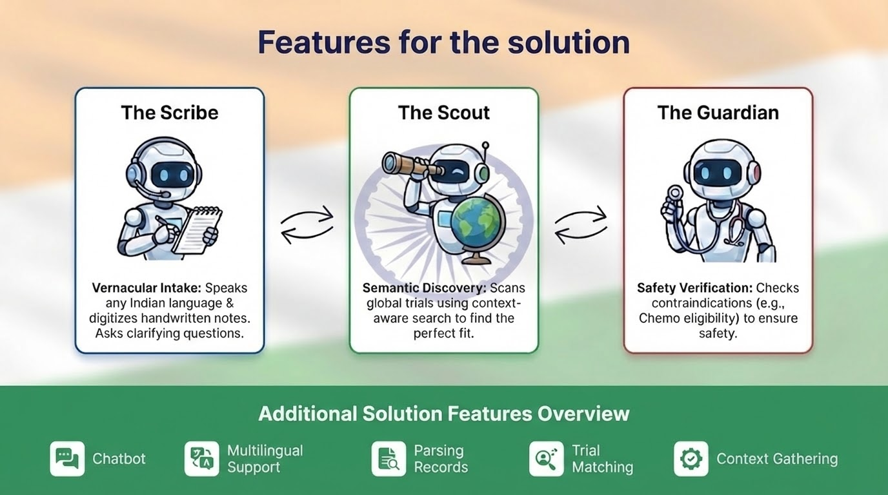

Slide 5
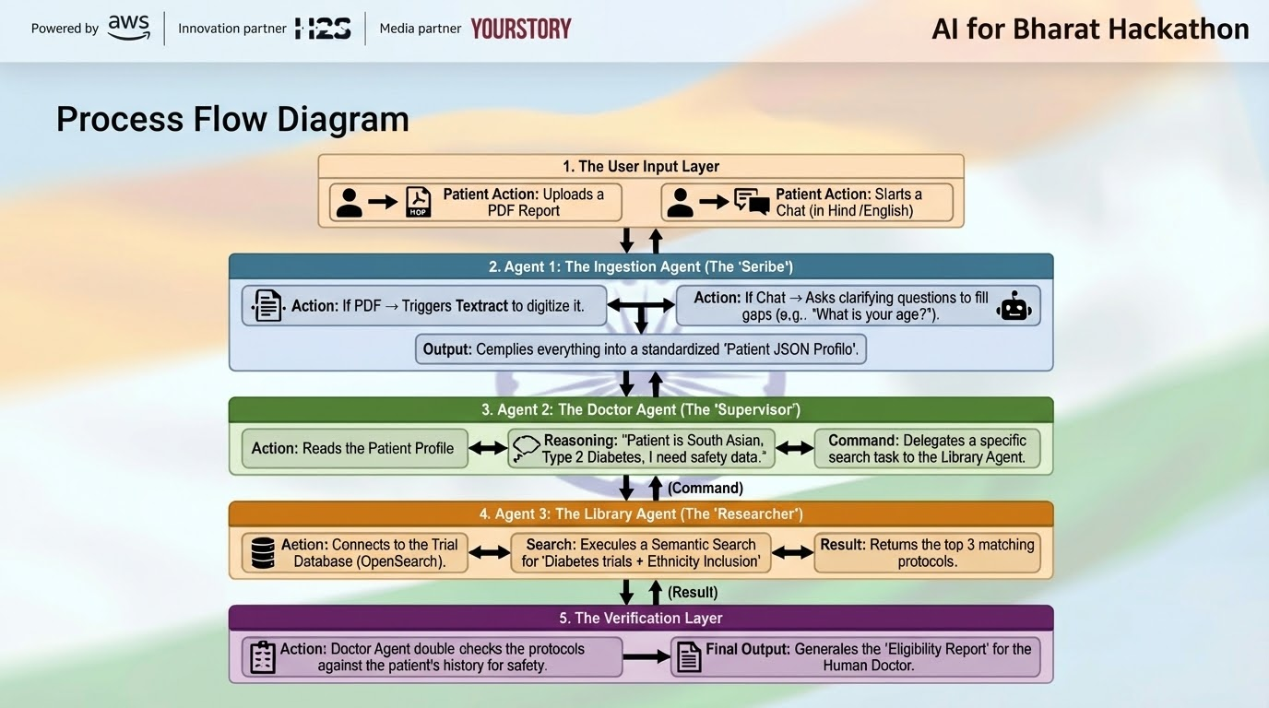

Slide 6
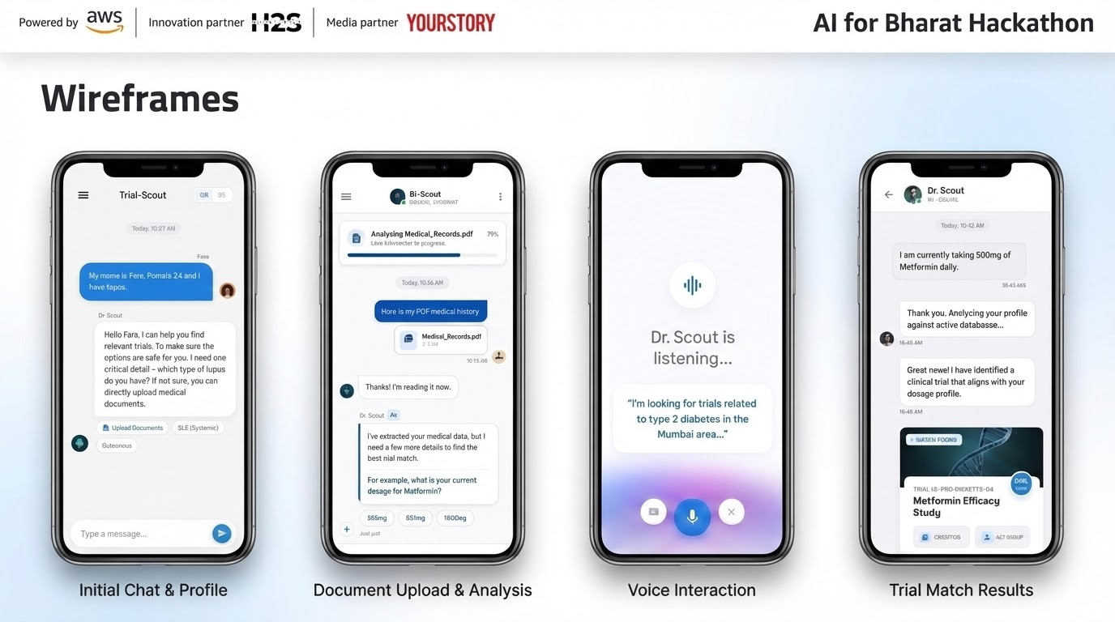

Slide 7
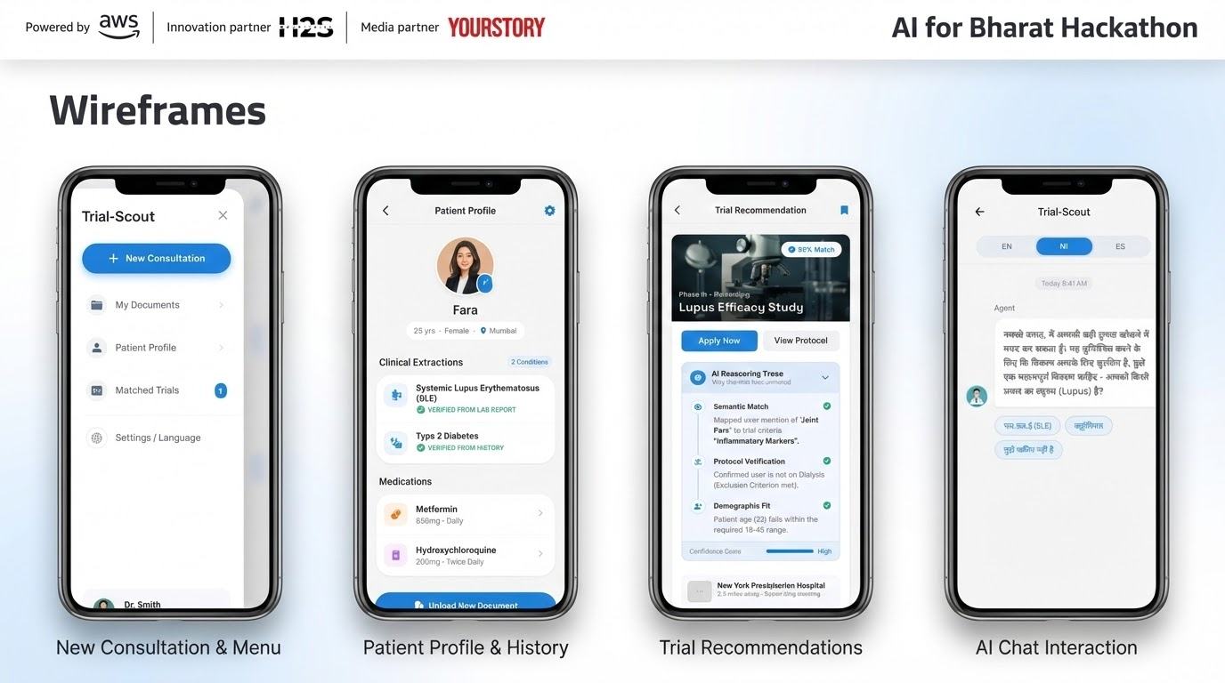

Slide 8
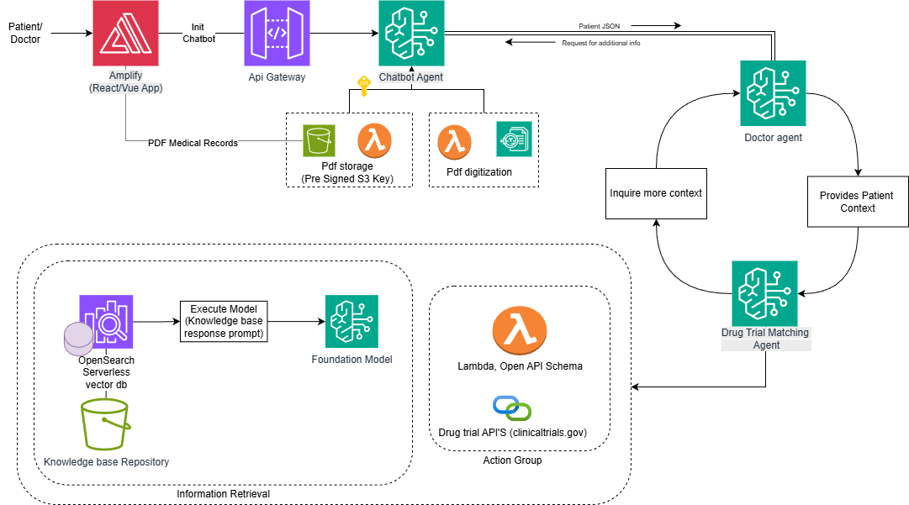
Architecture Diagram

Slide 9
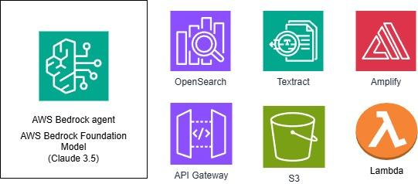
Technologies to be used in the solution:

Slide 10


